Slide 1
CP2404/CP5633 Database Modelling
Lecture 06

Slide 2
Lecture 6
Structured Query Language (SQL)
- Part 1 -
Reading: Coronel’s (12e) Chapter 7.1 ~ 7.5
(13e) Chapter 8.1 ~8.4
Notes:
2

Slide 3
Learning Objectives
In this lecture, you will learn:
The basic commands and functions of SQL
How to use SQL for data administration (to create tables, and indexes)‏
How to use SQL for data manipulation (to add, modify, delete, and retrieve data)‏
How to use SQL to query a database to extract useful information

Slide 4

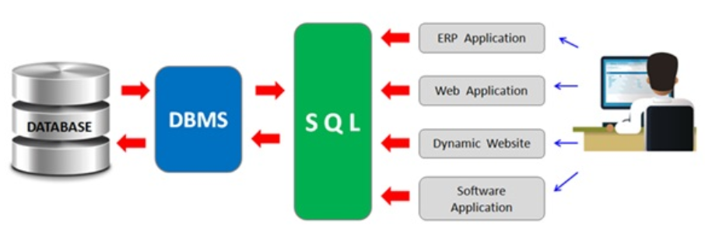
The Role/Position of SQL in a DB system
DB Administrator
Application Users

Slide 5
Structured Query Language (SQL)
SQL functions fit into two broad categories:
Data definition language (DDL)‏
Includes SQL commands:
To create database objects such as tables, indexes, and views
To define access rights to those database objects
Data manipulation language (DML)‏
Includes SQL commands:
To insert, update, delete, and retrieve data within the database tables

Slide 6
Structured Query Language (SQL)
SQL is relatively easy to learn
Basic command set has a vocabulary of less than 100 words
Nonprocedural language
American National Standards Institute (ANSI) prescribes a standard SQL
Several SQL dialects exist but differences in SQL dialects are minor

Slide 7
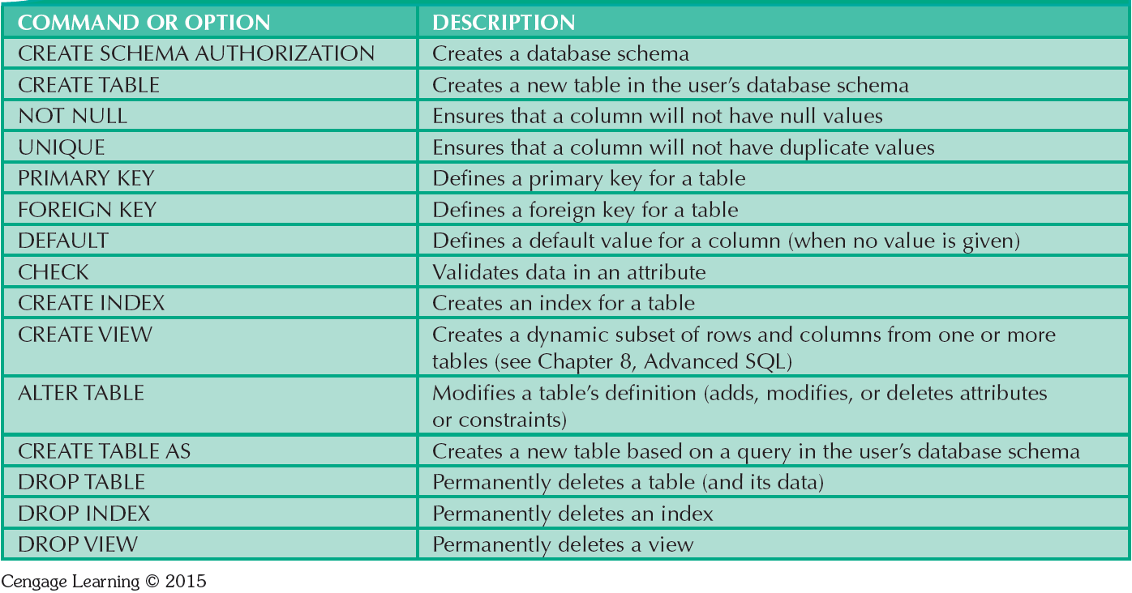
SQL Data Definition Commands

Slide 8
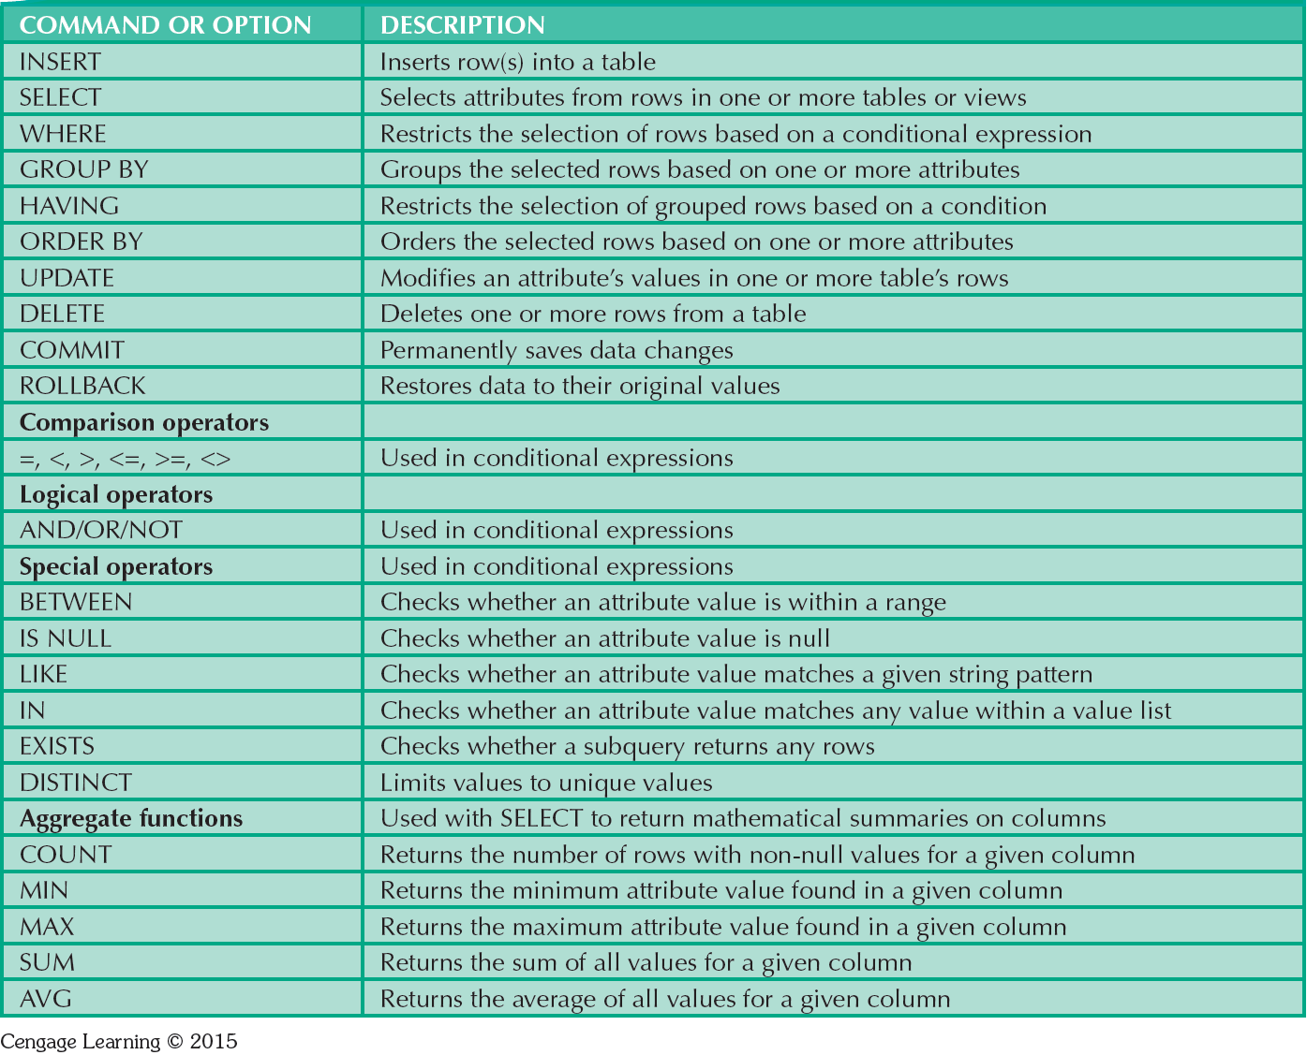
SQL Data Manipulation Commands

Slide 9
Note:
Most SQL commands/scripts used in this lecture notes followed the standard ANSI SQL, thus some of them may not be compatible to every DBMS.

Slide 10
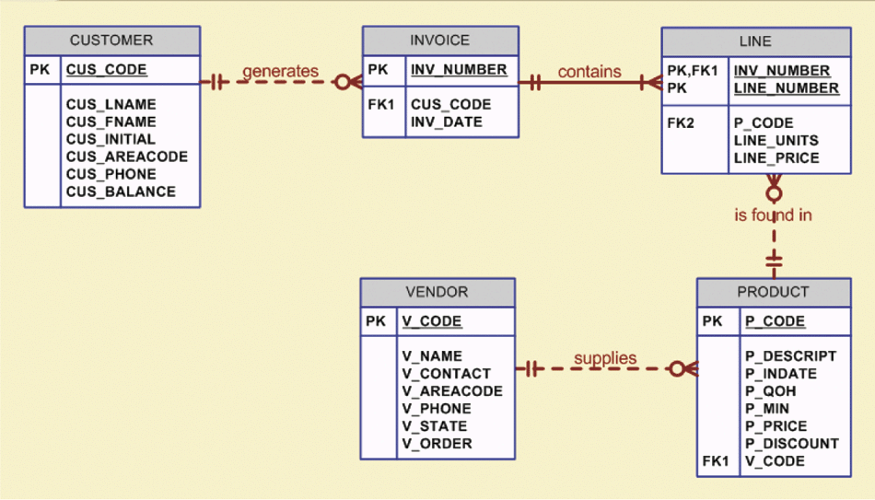
EXAMPLE: The Database Model

Slide 11
Creating the Database
Creating a new database involves two main tasks to be completed:
create database structure
create tables that will hold the end-user data
First task (create database structure)
RDBMS creates the physical files that will hold the database
differs from one RDBMS to another
Usually includes Authentication process

Slide 12
Creating the Database (Con’t)
Authentication
Process through which the DBMS verifies that only registered users access the database created
User should log on to the RDBMS using a user ID and a password created by the database administrator
Schema
Group of database objects—such as tables and indexes—that are related to each other
Syntax: CREATE SCHEMA AUTHORIZATION {CREATOR};
Example: CREATE SCHEMA AUTHORIZATION JONES;

Slide 13
Common SQL Data Types
After the database structure has been created, you need to define the table structures.
Data type selection is usually dictated by the nature of the data and by the intended use
Pay close attention to the expected use of attributes for sorting and data retrieval purposes
Common Data types include:
Numeric: number, integer, smallint, decimal
Character: char, varchar
Date

Slide 14
Some Common SQL Data Types | Format | Comments
Numeric | NUMBER(L,D) or NUMERIC(L,D) | The declaration NUMBER(7,2) or NUMERIC(7,2) indicates that numbers will be stored with two decimal places and may be up to seven digits long, including the sign and the decimal place (for example, 12.32 or −134.99).
 | INTEGER | May be abbreviated as INT. Integers are (whole) counting numbers, so they cannot be used if you want to store numbers that require decimal places.
 | SMALLINT | Like INTEGER but limited to integer values up to six digits. If your integer values are relatively small, use SMALLINT instead of INT.
 | DECIMAL(L,D) | Like the NUMBER specification, but the storage length is a minimum specification. That is, greater lengths are acceptable, but smaller ones are not. DECIMAL(9,2), DECIMAL(9), and DECIMAL are all acceptable.
Character | CHAR(L) | Fixed-length character data for up to 255 characters. If you store strings that are not as long as the CHAR parameter value, the remaining spaces are left unused. Therefore, if you specify CHAR(25), strings such as Smith and Katzenjammer are each stored as 25 characters. However, a U.S. area code is always three digits long, so CHAR(3) would be appropriate if you wanted to store such codes.
 | VARCHAR(L) or VARCHAR2(L) | Variable-length character data. T he designation VARCHAR2(25) or VARCHAR(25) will let you store characters up to 25 characters long. However, unlike CHAR, VARCHAR will not leave unused spaces. Oracle automatically converts VARCHAR to VARCHAR2.
Date | DATE | Stores dates in the Julian date format.

Slide 15
Creating Table Structure
Use one line per column (attribute) definition
Use spaces to line up the attribute characteristics and constraints
Table and attribute names are capitalized
NOT NULL specification for required attributes
UNIQUE specification when duplicates not allowed
Primary key attributes contain both a NOT NULL and a UNIQUE specification
RDBMS will automatically enforce referential integrity for foreign keys
Command sequence ends with a semicolon

Slide 16
Creating Table Structure
CREATE TABLE command
CREATE TABLE tablename (
column1 data type [constraint] [,
column2 data type [constraint] ] [,
PRIMARY KEY (column1 [, column2]) ] [,
FOREIGN KEY (column1 [, column2]) REFERENCES tablename] [,
CONSTRAINT constraint ] );
SQL constraints
FOREIGN KEY
NOT NULL
UNIQUE
DEFAULT
CHECK

Slide 17
Creating Table Structure
Table name
CREATE TABLE VENDOR (
V_CODE INTEGER NOT NULL UNIQUE,
V_NAME VARCHAR(35) NOT NULL,
V_CONTACT VARCHAR(15) NOT NULL,
V_AREACODE CHAR(3) NOT NULL,
V_PHONE CHAR(8) NOT NULL,
V_STATE CHAR(2) NOT NULL,
V_ORDER CHAR(1) NOT NULL,
PRIMARY KEY (V_CODE));
Column name
constraint
Datatype
Each line end with commas
Whole command end with a semicolon

Slide 18
SQL Constraints
NOT NULL constraint
Ensures that a column does not accept nulls
UNIQUE constraint
Ensures that all values in a column are unique
DEFAULT constraint
Assigns a value to an attribute when a new row is added to a table
CHECK constraint
Validates data when an attribute value is entered

Slide 19
Creating Table Structure
CREATE TABLE PRODUCT (
P_CODE VARCHAR(10) NOT NULL UNIQUE,
P_DESCRIPT VARCHAR(35) NOT NULL,
P_INDATE DATE NOT NULL,
P_ONHAND SMALLINT NOT NULL,
P_MIN SMALLINT NOT NULL,
P_PRICE NUMBER(8,2) NOT NULL,
P_DISCOUNT NUMBER(4,2) NOT NULL,
V_CODE INTEGER,
PRIMARY KEY (P_CODE),
FOREIGN KEY (V_CODE) REFERENCES VENDOR
ON UPDATE CASCADE);
Define a PK
Define a FK

Slide 20
Creating Table Structure
CREATE TABLE CUSTOMER (
CUS_CODE NUMBER PRIMARY KEY,
CUS_LNAME VARCHAR(15) NOT NULL,
CUS_FNAME VARCHAR(15) NOT NULL,
CUS_INITIAL CHAR(1),
CUS_AREACODE CHAR(3) DEFAULT '615' NOT NULL CHECK(CUS_AREACODE IN ('615','713','931')),
CUS_PHONE CHAR(8) NOT NULL,
CUS_BALANCE NUMBER(9,2) DEFAULT 0.00,
CONSTRAINT CUS_UI1 UNIQUE(CUS_LNAME,CUS_FNAME));
The default value is 615
Only 615, 713 931 are valid input
Prevent two customers to have same last name and first name

Slide 21
Creating Table Structure
CREATE TABLE INVOICE (
INV_NUMBER NUMBER PRIMARY KEY,
CUS_CODE NUMBER NOT NULL REFERENCES CUSTOMER(CUS_CODE),
INV_DATE DATE DEFAULT SYSDATE NOT NULL,
CONSTRAINT INV_CK1 CHECK (INV_DATE > TO_DATE('01-JAN-2002','DD-MON-YYYY'))‏
);
Date format
SYSDATE is a system function to return today’s date
Literal date
TO_DATE is a function to convert a string to DATE datetype
It takes two parameters, the literal date and the date format used

Slide 22
Creating Table Structure
CREATE TABLE LINE (
INV_NUMBER NUMBER NOT NULL,
LINE_NUMBER NUMBER(2,0) NOT NULL,
P_CODE VARCHAR(10) NOT NULL,
LINE_UNITS NUMBER(9,2) DEFAULT 0.00 NOT NULL,
LINE_PRICE NUMBER(9,2) DEFAULT 0.00 NOT NULL,
PRIMARY KEY (INV_NUMBER,LINE_NUMBER),
FOREIGN KEY (INV_NUMBER) REFERENCES INVOICE ON DELETE CASCADE,
FOREIGN KEY (P_CODE) REFERENCES PRODUCT(P_CODE),
CONSTRAINT LINE_UI1 UNIQUE(INV_NUMBER, P_CODE));
Use ON DELETE CASCADE to enforce referential integrity. Deletion of a row of the strong entity auto trigger the deletion of the corresponding rows in the weak entity.
Use UNIQUE to prevent duplication of an invoice line

Slide 23
SQL Indexes
When a primary key is declared, DBMS automatically creates a unique index
Often need additional indexes
Using the CREATE INDEX command, SQL indexes can be created on the basis of any selected attribute
Composite index
Index based on two or more attributes
Often used to prevent data duplication

Slide 24
Example of Index
You want to create an index and name it as P_CODEX
Table name, you want to create an index for table PRODUCT
Which column of the table you want to create an index for ?
To Create index on P_INDATE
CREATE INDEX P_CODEX ON PRODUCT(P_INDATE);
To Create composite index on V_CODE and P_CODE
CREATE INDEX VENPRODX ON PRODUCT(V_CODE,P_CODE);
To Create index on P_PRICE descendent order
CREATE INDEX PROD_PRICEX ON PRODUCT(P_PRICE DESC);
To Delete the PROD_PRICEX index
DROP INDEX PROD_PRICEX;

Slide 25
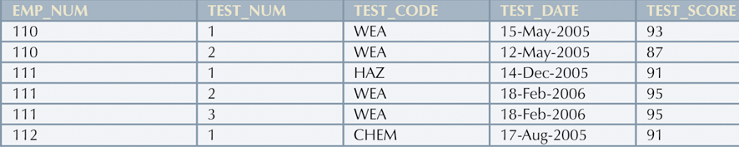
Composite Index Example: A Duplicated TEST Record
CREATE UNIQUE INDEX EMP_TESTDEX
ON TEST(EMP_NUM,TEST_CODE,TEST_DATE);

Slide 26
Data Manipulation Commands
INSERT - Adding table rows
COMMIT - Saving table changes
SELECT - Listing table rows
UPDATE - Updating table rows
ROLLBACK - Restoring table contents to state prior
to changes (since last COMMIT)
DELETE - Deleting table rows
INSERT + SELECT - Inserting table rows with a select
subquery

Slide 27
Adding Table Rows
Syntax
INSERT INTO tablename VALUES (v1,v2,…,vn);
Example:
INSERT INTO VENDOR
VALUES (21225,'Bryson, Inc.','Smithson','615','223-3234','TN','Y')‏
What if some data is missing? → use NULL
INSERT INTO PRODUCT
VALUES ('BRT-345','Titanium drill bit', '18-OCT-02', 75, 10, 4.50, 0.06, NULL)‏
One row of data per insert statement
a new tuple
(a list of attribute values)

Slide 28
Adding Table Rows (with optional attributes)
Some attributes are optional, instead of inserting NULL, we indicate which attribute that we have values
Specify we are going to insert some values into the P_CODE and P_DESCRIT columns
INSERT INTO PRODUCT(P_CODE, P_DESCRIPT)‏
VALUES ('BRT-345','Titanium drill bit')‏
These are the actual values to be inserted into the P_CODE and P_DESCRITP columns

Slide 29
Adding Table Rows
The INSERT operation can violate key constraints including:
Primary key entered that already exists
Primary key is null
Foreign key entered that does not correspond to a primary key in another table

Slide 30
Saving Table Changes
Changes made to table contents are not physically saved on disk until
Database is closed
Program is closed
COMMIT command is used (Not used in MS Access)
Syntax
COMMIT [WORK]
Will permanently save any changes made to any table in the database

Slide 31
Listing Table Rows
SELECT - Used to list contents of table
Syntax
SELECT columnlist FROM tablename
Columnlist represents one or more attributes, separated by commas
Asterisk * can be used as wildcard character to list all attributes
SELECT * FROM PRODUCT;
SELECT P_CODE, P_DESCRIPT, P_INDATE, P_ONHAND, P_MIN, P_PRICE, P_DISCOUNT, V_CODE
FROM PRODUCT;

Slide 32
Updating Table Rows
UPDATE- Modify data in a table
Syntax
UPDATE tablename SET columnname = expression [, columname = expression] [WHERE conditionlist];
If more than one attribute is to be updated in the row, separate corrections with commas
UPDATE PRODUCT
SET P_INDATE = ‘2004-01-08'
WHERE P_CODE = '13-Q2/P2'

Slide 33
Restoring Table Contents
ROLLBACK
Used to restore the database to its previous condition
Only applicable if COMMIT command has not been used to permanently store the changes in the database
Syntax
ROLLBACK;
COMMIT and ROLLBACK only work with data manipulation commands that are used to add, modify, or delete table rows
Some DBMSs (eg. MS ACCESS) don’t support COMMIT and ROLLBACK.

Slide 34
Deleting Table Rows
DELETE- Deletes a table row
Syntax
DELETE FROM tablename [WHERE conditionlist ];
WHERE condition is optional
If WHERE condition is not specified, all rows from the specified table will be deleted
DELETE FROM PRODUCT
WHERE P_CODE = '13-Q2/P2'
DELETE FROM PRODUCT
WHERE P_MIN = 5
DELETE command is dangerous!

Slide 35
Inserting Table Rows with a Select Subquery
Can insert multiple rows from another table
Use INSERT with a SELECT subquery
Query that is embedded (or nested) inside another query
Executed first
Syntax
INSERT INTO tablename SELECT columnlist FROM tablename ;
INSERT INTO VENDOR SELECT * FROM V;

Slide 36
Selecting Rows with Conditional Restrictions
Select partial table contents by placing restrictions on rows to be included in output
Add conditional restrictions to the SELECT statement, using WHERE clause
Syntax
SELECT columnlist FROM tablelist [ WHERE conditionlist ] ;

Slide 37
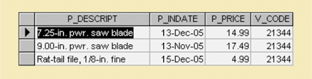
Query 1: Select with equality comparison
List all products supplied by Vendor 21344.
Output should contain description, in-date, price and vendor code.
SELECT P_DESCRIPT, P_INDATE, P_PRICE,V_CODE FROM PRODUCT WHERE V_CODE = 21344;

Slide 38
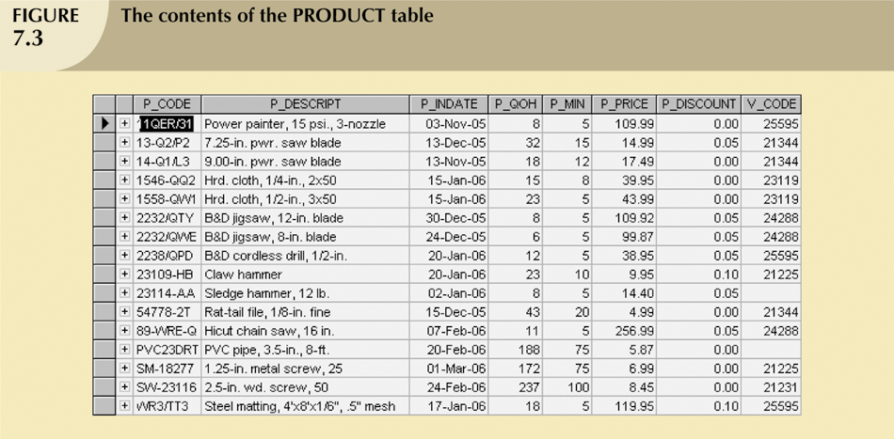
Example
Select PRODUCT table attributes (P_DESCRIPT, P_INDATE, P_PRICE, V_CODE) for vendor code 21344
SELECT P_DESCRIPT,P_INDATE,P_PRICE,V_CODE
FROM PRODUCT
WHERE V_CODE = 21344;

Slide 39
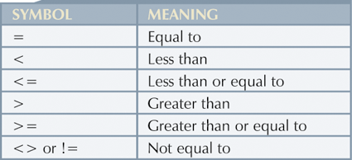
Comparison Operators
Selecting Rows with Conditional Restrictions

Slide 40
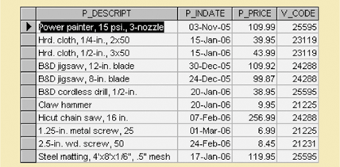
Query 2: Select with “not equal to” operator
List all Products supplied by a vendor other than 21344
Output should contain description, inventory date, price and vendor code.
SELECT P_DESCRIPT, P_INDATE, P_PRICE, V_CODE FROM PRODUCT WHERE V_CODE <> 21344;

Slide 41
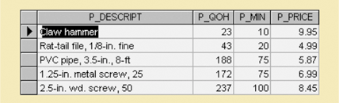
Query 3: Select with restriction
Find all products that cost $10.00 or less.
Output should contain description, number on-hand, minimum and price.
SELECT P_DESCRIPT, P_QOH, P_MIN, P_PRICE FROM PRODUCT WHERE P_PRICE <= 10;

Slide 42
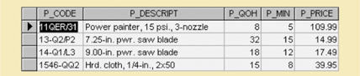
Query 4: Comparison on characters (The ASCII Code Effect)
List all products with product code less than 1558-QW1;
Output should contain product code, description, number on hand, minimum number, and price.
SELECT P_CODE, P_DESCRIPT, P_QOH, P_MIN, P_PRICE FROM PRODUCT WHERE P_CODE < ‘1558-QW1’;

Slide 43
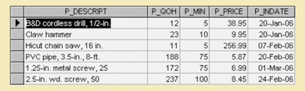
Query 5: Date comparisons
List all products with inventory dates on or after January 20, 2004.
Output should contain description, number on hand, minimum number, price and inventory date.
SELECT P_DESCRIPT, P_QOH, P_MIN, P_PRICE, P_INDATE FROM PRODUCT WHERE P_INDATE >= ‘2004-01-20’;
MySQL specific format to present a date value (using the single quotation marks)
Note:
Different format can be used depending on DBMSs

Slide 44
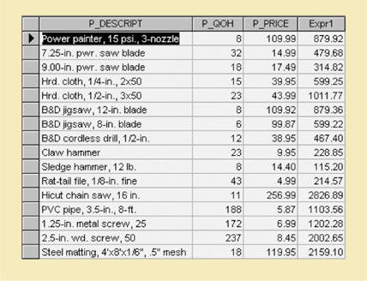
Query 6: SELECT Statement with a Computed Column
List the total value of each of the products.
Output should contain description, number on hand, price and computed value.
Output of the computed value column named Expr1
SELECT P_DESCRIPT, P_QOH, P_PRICE, P_QOH*P_PRICE FROM PRODUCT;
You can include computation expression
in SQL

Slide 45
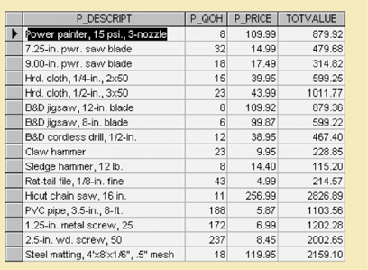
Query 6a: SELECT Statement with a Computed Column and an Alias
Output of the computed value column named TOTVALUE
SELECT P_DESCRIPT, P_ONHAND, P_PRICE, P_QOH*P_PRICE AS TOTVALUE FROM PRODUCT;

Slide 46
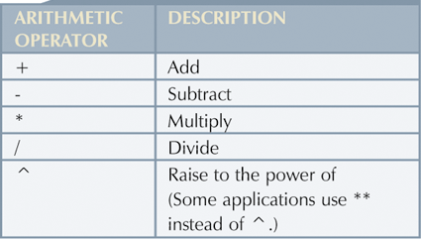
Arithmetic Operators: The Rule of Precedence (which operator goes first ?)‏
Perform operations within parentheses
Perform power operations
Perform multiplications and divisions
Perform additions and subtractions

Slide 47
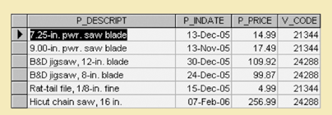
Query 7: The Logical OR
List the products supplied by either vender 21344 or vendor 24288.
Output should contain description, inventory date, price and vendor.
SELECT P_DESCRIPT, P_INDATE, P_PRICE,V_CODE FROM PRODUCT WHERE V_CODE = 21344 OR V_CODE = 24288;

Slide 48
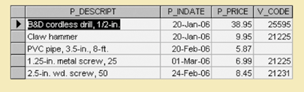
Query 8: The Logical AND
List the products that cost less then $50 and have an inventory date occurring after January 15, 2004.
Output should contain description, inventory date, price and vendor.
SELECT P_DESCRIPT, P_INDATE, P_PRICE,V_CODE FROM PRODUCT WHERE P_PRICE < 50 AND P_INDATE > ‘2004-01-15’;

Slide 49
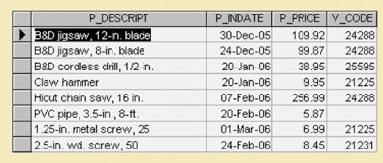
Query 9: The Logical AND and OR
List the products that cost less then $50 and have an inventory date occurring after January 15, 2004, or are supplied by vendor 24288.
Output should contain description, inventory date, price and vendor.
SELECT P_DESCRIPT, P_INDATE, P_PRICE,V_CODE FROM PRODUCT WHERE (P_PRICE < 50 AND P_INDATE > ‘2004-01-15’) OR V_CODE = 24288;
Parentheses are important!

Slide 50
Special Operators
BETWEEN
Used to check whether attribute value is within a range
IS NULL
Used to check whether attribute value is null
LIKE
Used to check whether attribute value matches given string pattern
IN
Used to check whether attribute value matches any value within a value list
EXISTS
Used to check if subquery returns any rows
SELECT *
FROM VENDOR
WHERE EXISTS (SELECT * FROM PRODUCT WHERE P_QOH<=P_MIN);
SELECT *
FROM VENDOR
WHERE V_CODE IN (SELECT V_CODE FROM PRODUCT);
SELECT *
FROM PRODUCT
WHERE P_PRICE BETWEEN 50.00 AND 100.00;
SELECT *
FROM PRODUCT
WHERE P_DESCRIPT LIKE ‘B%’;
SELECT *
FROM PRODUCT
WHERE V_CODE IN (‘21344’,’24288’);
SELECT *
FROM PRODUCT
WHERE V_CODE IS NULL

Slide 51
Summary
SQL commands can be divided into two overall categories:
Data definition language commands
Data manipulation language commands
Basic data definition commands allow you to create tables, indexes, and views
Many SQL constraints can be used with columns

Slide 52
SQL In-Class Exercises

Slide 53
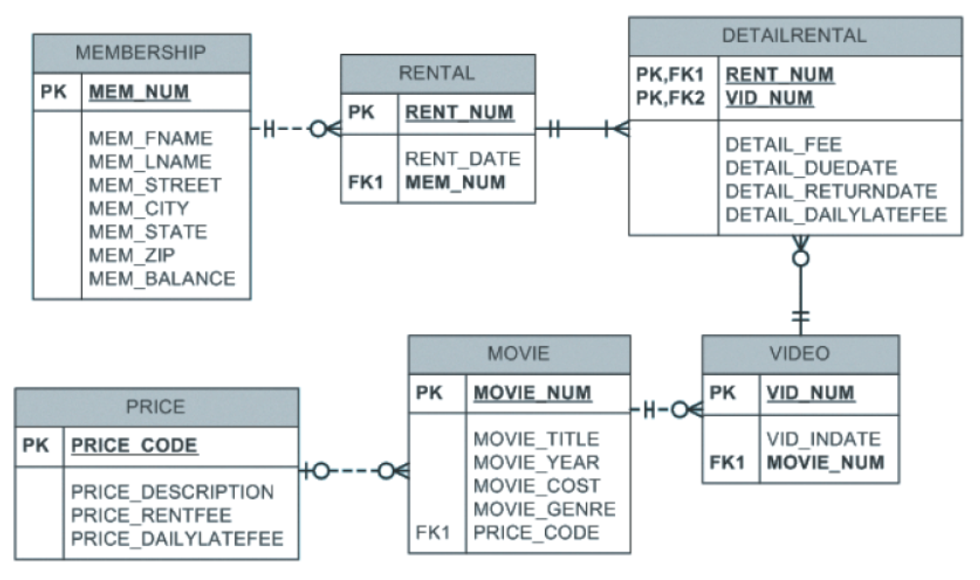
Write the SQL command to change the movie year for movie number 1245 to 2014.
UPDATE MOVIE
SET MOVIE_YEAR = 2014
WHERE MOVIE_NUM = 1245;

Slide 54
Write the SQL command to change the price code for all action movies to price code 3.
UPDATE MOVIE
SET PRICE_CODE = 3
WHERE MOVIE_GENRE = 'ACTION';

Slide 55
Write a single SQL command to increase all price rental fee values in the PRICE table by $0.50
UPDATE PRICE
SET PRICE_RENTFEE = PRICE_RENTFEE + .5;

Slide 56
Write the SQL command to reduce $2.00 to the member balance whose name is Joanne Lee.
UPDATE MEMBERSHIP
SET MEM_BALANCE = MEM_BALANCE - 2
WHERE MEM_FNAME = ‘Joanne’ AND MEM_LNAME = ‘Lee’;

